Slide 1
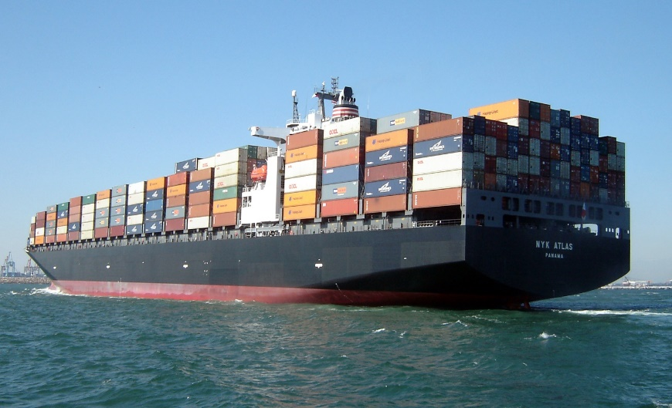
Du poste de DEV à AZURE:
le voyage d’une application

Slide 2



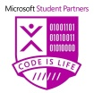
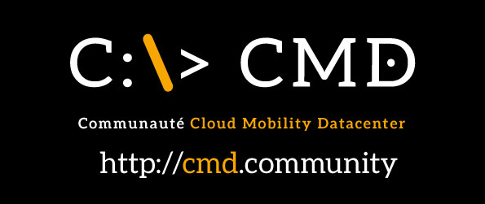
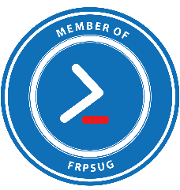
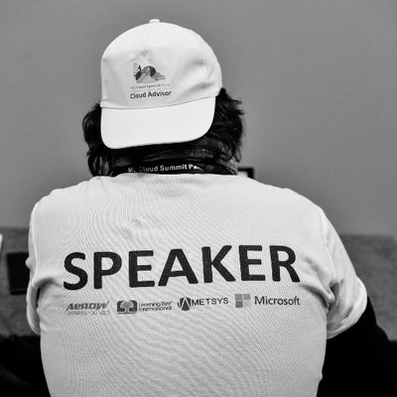


Fabien DIBOT
MVP Cloud Datacenter
Azure Solutions Architecte
ORANGE BUSINESS SERVICE
@fdibot
Baptiste COUDOULET
Microsoft Student Partner
Etudiant EPITECH Nice
@bc2606
JF BÉRENGUER
MVP Cloud Datacenter
Microsoft Regional Director
Responsable des opérations Gand Sud
PROJETLYS
@jfberenguer_pro
David SEBBAN
MVP Windows and Devices
For IT
Responsable Agence Sud Ouest
NELITE
@davidsebban

Slide 3
Pré requis
Tenant Azure
Azure CLI
Docker for Windows ou for Mac
Kubectl command line tool
Visual studio code ou autre éditeur

Slide 4
Présentation du Lab
Atelier 1 : Déployer une application dans l'environnement Docker local et manipuler les commandes de base de Docker
Atelier 2 : Créer une Container Registry dans Azure et exporter les images
Atelier 3 : Création d'un cluster Kubernetes dans Azure et déploiement de l'application

Slide 5
Présentation du Lab
Atelier 4 : Manipulation des outils Kubernetes en particulier pour les fonctions de mise à l'échelle
Atelier 5 : Mise en œuvre de la supervision via Azure Log Analytics
Atelier 6 : Création d'un container pour exécuter MineCraft et utiliser l'infrastructure créée dans les ateliers précédents pour le faire exécuter au sein du cluster Kubernetes

Slide 6
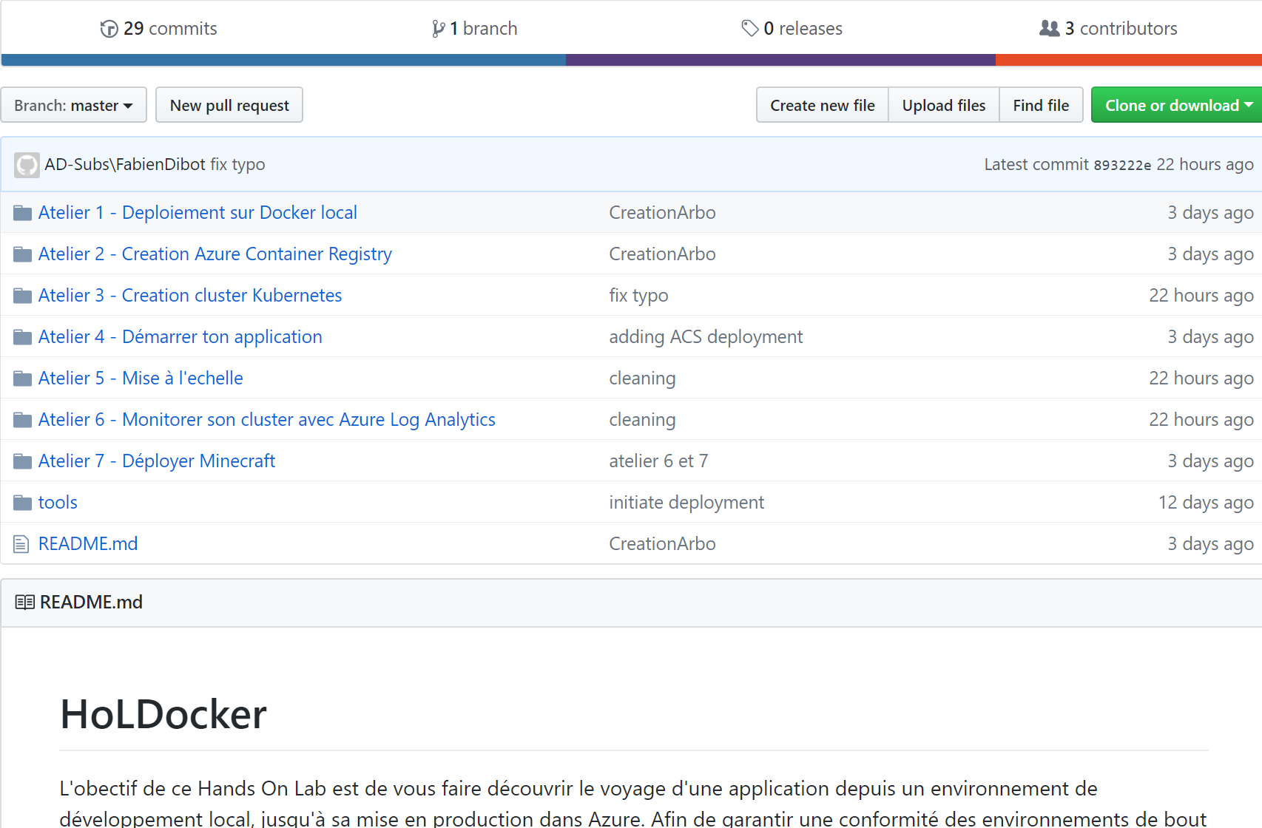
Le LAB
https://github.com/fabiendibot/HoLDocker

Slide 7
Quelques concepts..

Slide 8

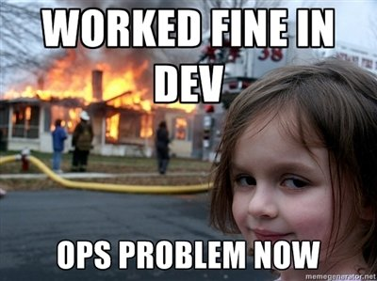


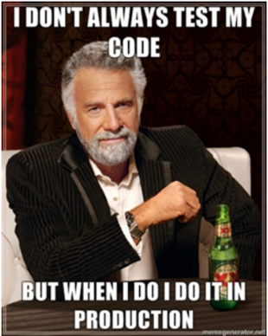
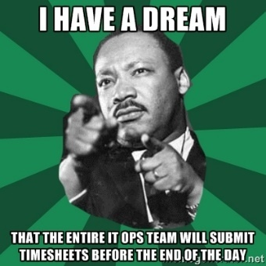
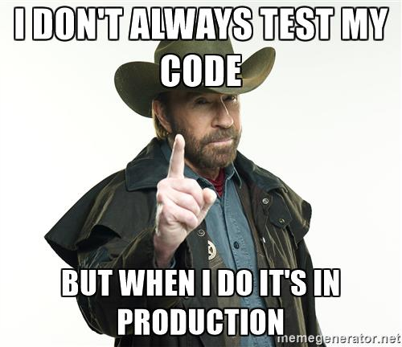
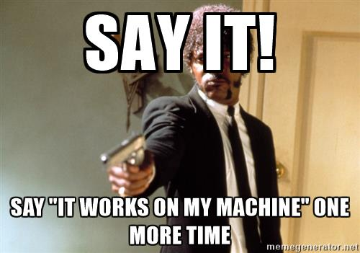

Ca vous rapelle quelque chose ?

Slide 9
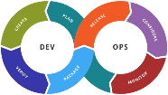
La solution pour la DSI :
Agile
Référentiel
Micro
Services
Intégration
continue
Infrastructure as a Code
Déploiement Continu
Monitoring

Slide 10
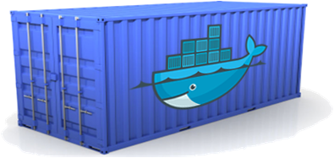
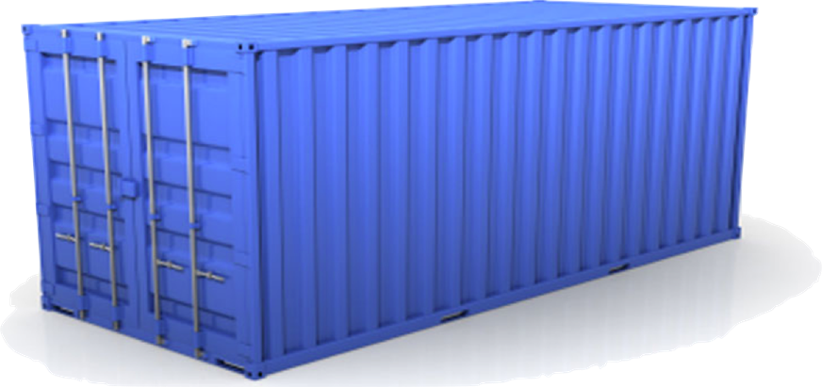
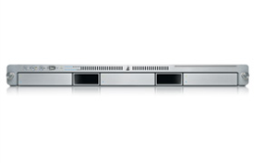
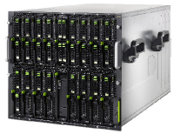
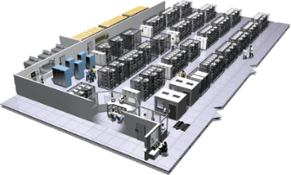
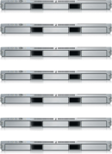


Concepts : les containers:
Multiplicité des piles applicatives
Queue
Est ce que les
services et
applications
interagissent de
manière appropriée ?
Static website
Web frontend
User DB
Analytics DB
Multiplicité des
plates-formes
matérielles ou
virtuelles
Est-ce que je peux migrer rapidement et de manière fluide?
Development
VM
QA server
Customer
Data Center
Public Cloud
Production Cluster
Contributor’s
laptop

Slide 11
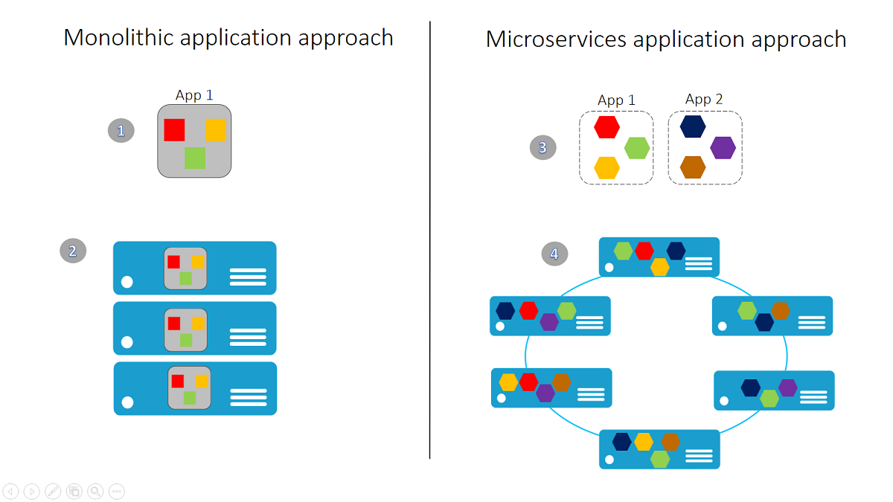
Concepts : les micro-services

Slide 12
Docker file vs docker-compose
Docker file : pour une seul container
Docker-compose (*.yml) pour microservices = containers multiples

Slide 13
Common Docker CLI Commands
docker run - Use an image to run a container
docker pull - Pull an image from a registry
docker build - Build a Docker image
docker images - List available Docker images
docker ps - List running Docker containers
docker exec - Execute a command in a container
docker stop - Stop a running container
Notes:
These are some of the most commonly used docker commands. You can also use docker push to push an image to a registry such as Docker Hub. Also, docker ps is often accompanied by a -a switch to list all containers, including those that are no longer running, while docker rm and docker rmi are used to delete (remove) containers and images, respectively. The docker build command uses a Dockerfile (a text file containing build commands) and a "context" -- for example, a specified directory in the file system -- to build Docker images.

Slide 14
Running a Container
docker run -i -t ubuntu /bin/bash
Docker CLI command
Run container with interactive terminal
Pull "ubuntu" image from Docker Hub or local registry
Command to execute in the container
Notes:
This command pulls the image named "Ubuntu" from Docker Hub (or a local registry if the image is cached there) and runs it interactively in a container. "Interactively" means standard input, output, and error are connected locally so you can provide input to the container and see its output. Of course, you are not limited to the "Ubuntu" image. You can specify other images and even create images of your own with docker build. Where the container runs depends on the context. The container can run locally in a docker host (for example, a VM on Windows), or it can remotely if you connect to a remote Docker daemon (for example, one running in Azure) via SSH tunneling and use port forwarding to forward docker commands to the daemon.

Slide 15
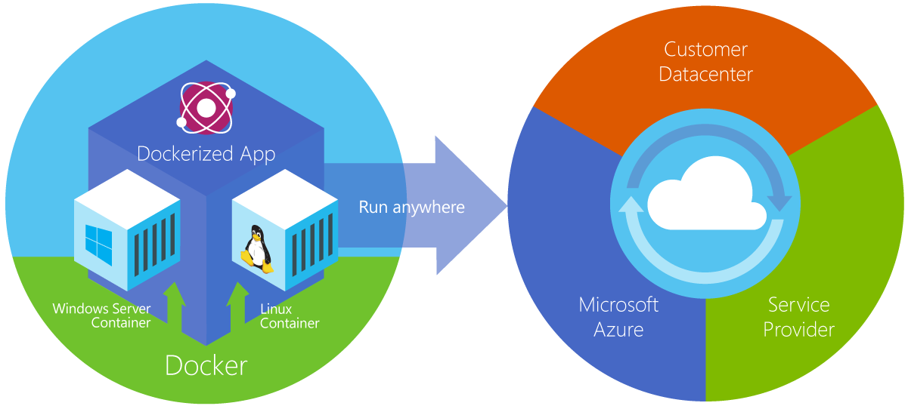
Azure Container Service
Service Azure qui fournit un environnement complet et prêt à l’employ pour les environnements Docker
Utilise les outils d’orchestration open-source (DC/OS and Swarm)
Notes:
From the documentation: "Azure Container Service makes it simpler for you to create, configure, and manage a cluster of virtual machines that are preconfigured to run containerized applications. It uses an optimized configuration of popular open-source scheduling and orchestration tools. This enables you to use your existing skills, or draw upon a large and growing body of community expertise, to deploy and manage container-based applications on Microsoft Azure." ACS supports Linux containers and Windows containers. The latter rely on Windows Server 2016.

Slide 16
Kubernetes
Scalabilité des conteneurs
Scalabilité des nœuds du cluster
Portabilité
Intégration dans Azure

Slide 17
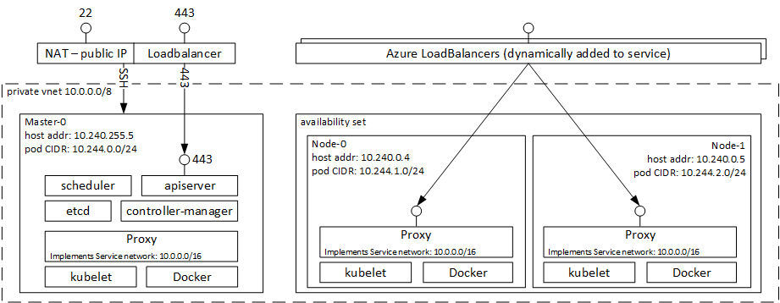
Kubernetes

Slide 18
Kubernetes
apiVersion: apps/v1beta1
kind: Deployment
metadata:
name: minecraft
namespace: azure
spec:
replicas: 1
template:
metadata:
labels:
app: minecraft
spec:
containers:
- name: minecraft
image: holdocker2018.azurecr.io/minecraft:0.1.0
ports:
- containerPort: 25565
imagePullSecrets:
- name: azureregistry
YAML or JSON
Déclarative
Simple
Idempotent

Slide 19
Notes:
Today’s small business owners face daily challenges in running their businesses, and one of the more difficult challenges can include managing an IT infrastructure. We designed Windows Server 2016 to help…
Safeguard your business:
Microsoft technologies have protections built-in to help safeguard data across devices and apps onsite or in the cloud, help you recover from business disruptions.
Improve IT efficiency & productivity
To help deliver increased efficiency and maximize your IT investment, Microsoft’s technology gives you the business tools of a much larger company, at the right price.
Ready for the cloud:
Whether you are moving to the cloud now or in the future; Get the best of both worlds, Microsoft technologies are design for hybrid cloud IT environments.

